Slide 3
Notes:
I will briefly give you an an overview of what this ppt is all about.

Slide 4
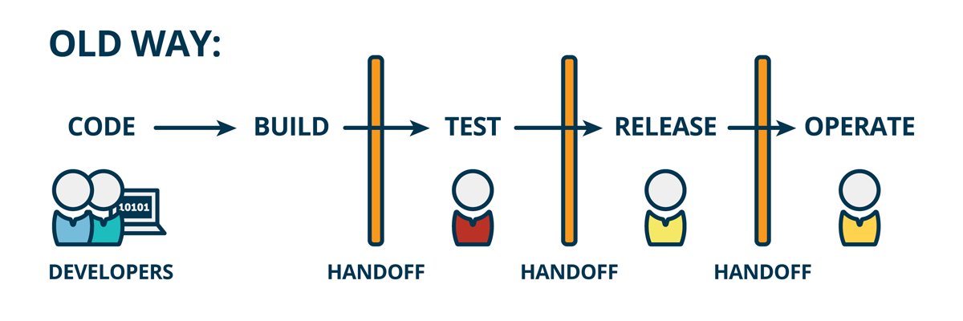
Traditional Software Development Process
Each Step is done manually
Notes:
20
Where several developers used to code, Occasionally or after a specific period, all the progress was integrated.
Then it was built, tested and released for the operations team. But each of these steps were done manually.

Slide 5
Drawbacks Of The Traditional Software Development Process
Infrequent code integration → Infrequent builds → tough debugging → More time
Less number of releases → Tested only a few times → Poor Quality
Repetitive Manual work of Integrating, Building and Testing the code
Notes:
30 The problem with this methodology is :
Because there is a large gap b/w integration, even separate codes working perfectly fine may encounter some bugs & may not work when integrated together.
As the gap b/w development and integration increases, it becomes more difficult to debug the integration bugs and a lot of time is wasted to fix a code which was perfectly working !
Because of al this, the number of releases decrease, lack in testing, poor quality.

Slide 6

Continuous Integration & Continuous Deployment
Notes:
Integrate as you develop

Slide 7
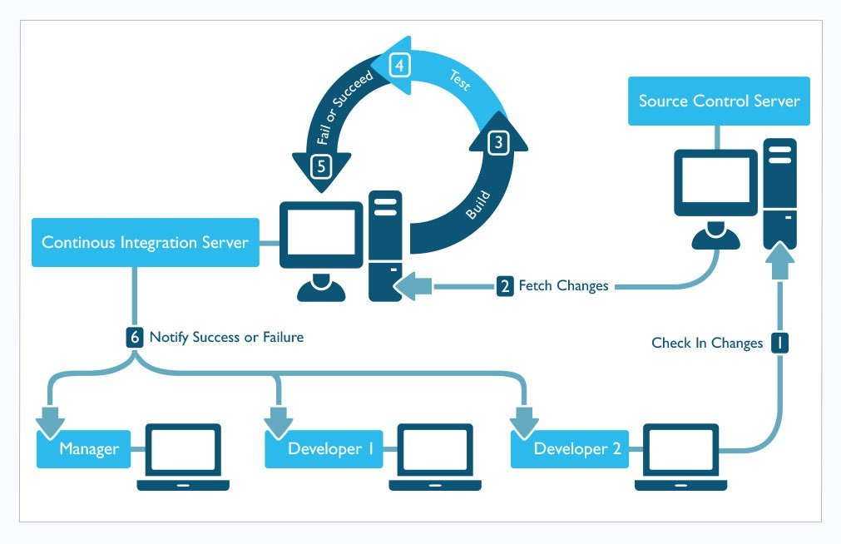

Notes:
20
If you look at this system, this is the CI server which takes care of all the manual work and automates it. IT keeps a check on the SCM. As soon as there is any changes / commit, it automatically pulls the source code, builds it, tests it and sends the report to the developers.
Here, Developers don’t need to wait for integration. They only need to push their codes. Rest everything is automated and CONTINOUS. There is no gap b/w development and integration.
As soon as there is a push, integration is triggered and building and testing is started. In case there are any bugs, they can be detected and fixed immediately. Continuously integrates code as it is developed.
This automated environment is called CI/CD

Slide 8
Problems In Introducing CI/CD
Lack of portability
Inconsistencies in the development & production environment
Unnecessary increase in Man-hours
Lack of rigorous testing
Difficult to maintain good Quality
Increased Delivery time
Re-installing the same Jenkins configured environment for different projects.
Unnecessary cost of constructing the infrastructure
Notes:
40
But the problem is creating such an environment is costly.
The environment that each developer uses while developing the code, might be different than the environment used while building the integrated code. Because the code was developed with some specific dependencies and versions, difference in the enviroenmnt may lead to unexpected behavior of the code -> inconsistency. So, the env needs to setup at the production side same as the development side. Since CI/CD is not portable, one has to set it up again at the production side. The configurations and installations are not portable.
This increases the time to prepare the environment and repetitive efforts as well.
Also, same thing happens when you deploy the project to the production. Debvelopment to produfion porting env may differ which leads to unnecessary bug fixes a…. Difference in prod and dev environment

Slide 9
My mission
Introduce a portable CI/CD environment
Develop a set of DevOps tools with a containerized technology.
“
”
Notes:
20
In the Docker World….
What is a container : eg. Jenkins container is a running instance of jenins image. Jenkins image …. About Docker : System of container, images, Dockerfile, registry everything briefly
To develop a set of DevOps tools to introduce a portable CI/CD in an efficient and feasible way I am using Containerized Technology to implement my mission.
Which in my case is Docker. In the docker world, everything exists as an image on a central repo called Docker Hub. Anyone can pull the image and use it. The biggest advantage is that since the image is packed with all the needed tools and dependencies with the best compatible versions, the envrionemnt is same everywhere.
These images can be customized and run deployed in docker containers.

Slide 10
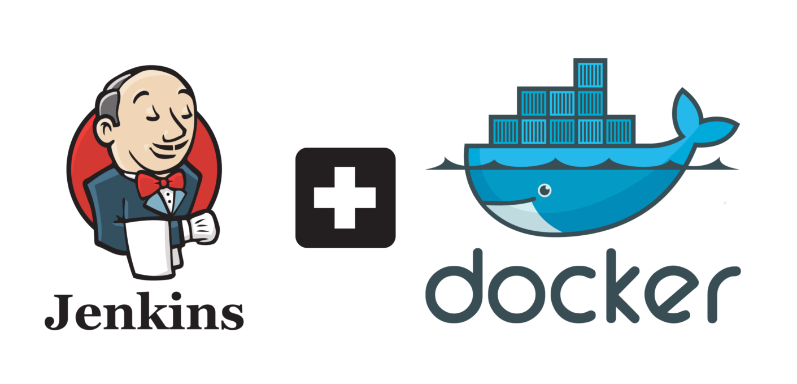
CI/CD with Docker
My mission
Notes:
5

Slide 11
Docker intro

Slide 12
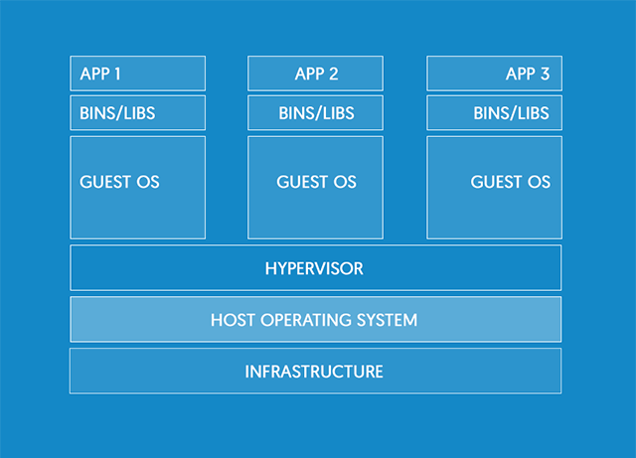
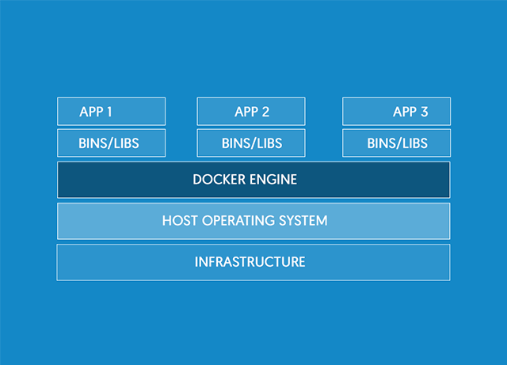
Docker Containers
VM
Container
Different Apps on Different Guest OS
Different Apps on Different Containers but all containers on the same OS
Notes:
20
In the VM environment, there are multiple guest OSs on 1 host OS. But in containers … Docker and container environment, difference from VM and how its better

Slide 13
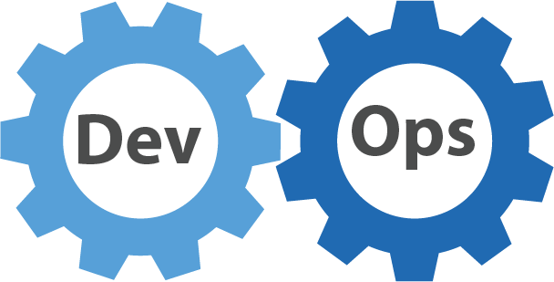
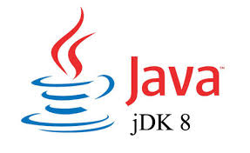



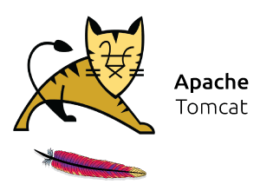

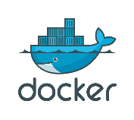

System components & terasoluna framework
Category | Tools
Project | Terasoluna
Source Code Language | Java
Build Tool | Maven
Integration Testing | Selenium
Database | PostgreSQL
Deployment Server | Apache Tomcat
CI Server | Jenkins
Container Technology | Docker
Source Code Management | Gitlab
Notes:
15
Tera is a java project, maven is the build tool, postgresql is db … I have designed this system for sample Terasoluna app using …tech stack…. I learnt these many things in the course of internship

Slide 14
System Configuration of my project

Slide 15


System Configuration
Maven
Tomcat
PostgreSQL
Selenium
Linux
Linux
Linux
JENKINS CONTAINER
BUILD CONTAINER
DEPLOY & TEST CONTAINER
DOCKER ENGINE
Source Code Management
KERNEL
Docker hub
HOST OS
Notes:
30 Jenkins inside a container and etc etc
I have constructed 3 containers in my system :
Jenkins container which automates the entire process and trigger other containers.
Build Container : which builds the java code using maven and runs unit test using Junit.
Deploy & test Container : The App is built successfully is deployed inside this container on the tomcat server and then selenium is used to run integration tests on it.
Docker Engine is the key to the entire system. It facilitates the communication.
Gitlab is the SCM where the source code is pushed.

Slide 16



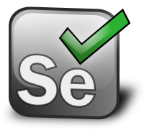
Work flow
Push changes to repository
Jenkins Polling
Triggers build container
Build & Unit Test
Build container
Artifacts are archived
Jenkins container
Artifacts deployed for testing
Deploy & Test
DOCKER ENGINE
Notes:
40 This is the kind of system that I have built Tell them how the entire process is divided into stages
How you made the containers and all
The Jenkins container is connected with the Gitlab repo and it keeps polling the repo for changes.
As soon as developers push their code to the repo, because Jenkins is polling it, it detects the change in repo
And triggers a new container : The Build Container.
This Build Container uses maven to build the project and runs unit tests on it.
If there is a failure, reports are sent to the developers.
On a successful build, the outcome of the build ie the artifacts, WAR file in my case are preserved in the Jenkins container.
The Jenkins container then triggers the deploy container. The artifacts are deployed in this container, and integration testing using selenium is performed.
Reports are sent to the developers.

Slide 17
How did docker help ? What did you do ? Demonstration
Notes:
60 Demo
I will just push a dummy commit on the repository and show you how the automation works.

Slide 18
Notes:
Now I will show you how I developed this ? Procedure to launch a container….
Setting up Jenkins :
Setting it inside a docker container
Docker pull Jenkins
Now that I have the image, I can install all the plugins and tools needed for my project.
Once I have my Jenkins ready, I can preserve the enviroemnyt as it is in a docker image and this can be ported anywhere anytime. The configuration and serttings about the envrioemnt are all written inside the Dockerfile.
Similarly I constructed the build container by installing maven postgreql and other needed tools on top of the base linux docker image.
Because of the images available, setting up environment is really easy and fast.

Slide 19
How my work solves the problem ?
Notes:
20 Docker features, adv of containers

Slide 20
Comparison
Task | Docker Way | Old Way | Time
Environment Preparation | Install Docker Engine | Setup VM
Launching the CI Server | Docker pull Jenkins Launch | Install Jenkins and all its dependencies on the machine manually and configure it. Configure the build server. Setup a Jenkins agent for communication.
Notes:
40 Metric comparison with the prev way of introducing ci/cd

Slide 21
CONCLUSION
Mission successful
Optimized the following :
Time
Quality
Development cycles
Cost
Notes:
60 Use cases future scope and then conclude …microservices
More releases -> more rigorous testing -> better quality
Its clear that the containerized way of introducing CI/CD significantly benefits us in term of Time, shorter development cycles, more releases, rigourpous tresting , better wuality
Hence Time to market, Quality and Cost are all optimized.

Slide 22
Notes:
Vote of thanks, pictures of japan and all events and thanking everyone for everything I would like to thank my trainer Philip-san for helping me build this system and my manager Nagashima-san for keeping me motivated to complete this.
This is a glimpse of my internship in Japan.
Thanks to the HR Team for organizing such amazing events and giving us some unforgettable memories.
Thank you !

Slide 23
QUESTIONS ?

Slide 24
REFERENCES

Slide 25
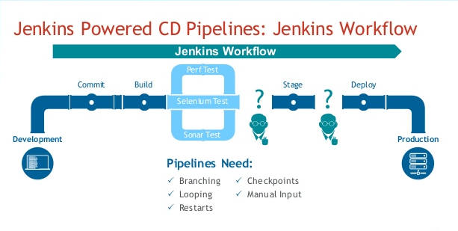
Notes:
20 Aim is to introduce this workflow using docker I have constructed containers for every stage : Build & Ubnit Testing, Integartion testinh

